Slide 1
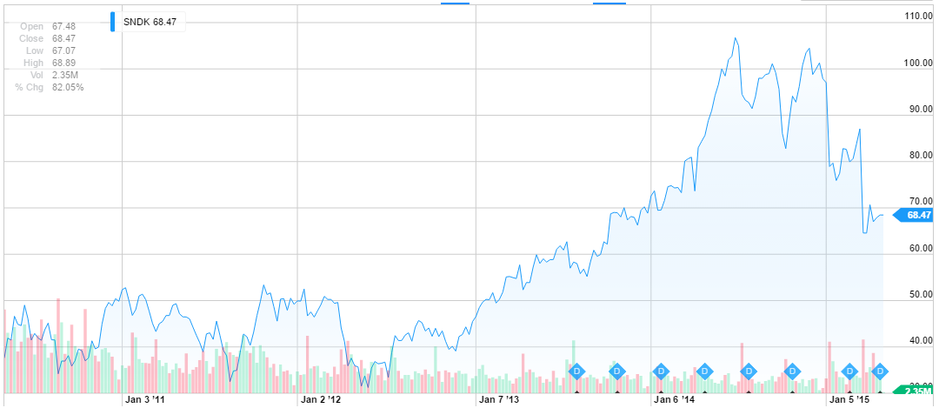
SanDisk Corporation (SNDK)
Arman Hastings
May 2th, 2015 Technology

Slide 2

Business Overview
History
- SanDisk IPO at $10.00/Share, November 1995.
- SanDisk and Toshiba began their joint venture, 1999.
Primary Product Target Markets
Data Center
Storage solutions for data centers or cloud data centers.
Computing
Storage systems for average computer systems, to high end performance systems.
Consumer Electronics
Memory for any other niche products
Mobile
Flash storage in smartphones, tablets, or phones. Mostly imbedded storage solutions used.

Slide 3
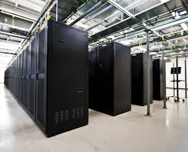
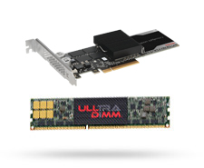
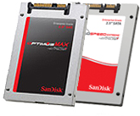
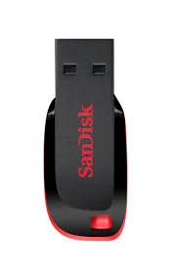
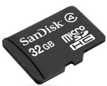
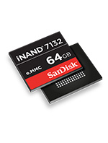
Business Overview
Overview
- Global leader and innovator in data storage.
- Focus on
Primary Product Target Markets
- Flash & NAND memory for cameras, phones and usb drives.
- Flash-based SSD for computers and other products.
- Wireless memory, Embedded storage, and Music Players, Wafers & Components
- Data Center Software

Slide 4
Business Channels
Retail Sales Channel
- Consumer electronic stores
- Office superstores
- Online sales
Commercial Sales Channel
- Original Equipment Manufacters (OEM)
- System Integrators

Slide 5


Corporate Governance
Sanjay Mehrotra
President & Chief Executive Officer
Co-founder of SanDisk
Background of Electrical Engineering and Computer Sciences
Also serves on the board of:
Cavium: Semiconductor Technology
Global Semiconductor Alliance
Eli Harari
Former Chairman and Chief Executive Officer
Received the 2009 IEEE Robert N. Noyce Medal
ISS Governance Score 8: Audit: 1; Board: 8; Shareholder Rights: 9; Compensation:7

Slide 6
Competitive Positioning
Competitiveness:
Product reliability and differentiation
Price, quality and availability of products
Success in developing new products, applications and markets
Timing of new product announcements and successful introductions
Ability to adapt to consumer demands

Slide 7

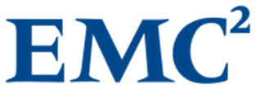
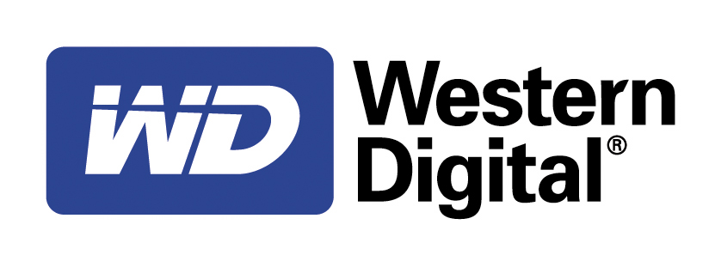
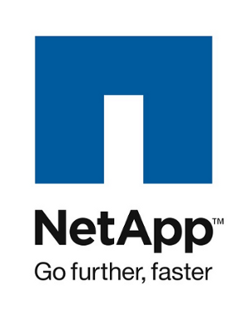
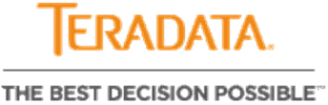
Competitive Positioning
Seagate Technology specializes is very similar- therefore a big competitor to SanDisk.
EMC offers data storage, information security, virtualization, analytics, and cloud computing
One of the largest computer hard disk drive manufacturers in the world and sells storage devices
NetApp is an American computer storage and data management company that supplies hardware and software.
Teradata American computer company that sells analytic data platforms, applications and related services.

Slide 8
Current Events (if relevant)
SanDisk launched a new category of “Big Data Flash”
with the launch of the InfiniFlashTM System, a next generation storage platform offering flash at massive scale and at a breakthrough cost metric for the customer.
SanDisk Develops worlds highest capacity microSD
SanDisk introduced the 200GB* SanDisk Ultra® microSDXC™ UHS-I card, the world’s highest capacity microSDTM card for use in mobile devices.
SanDisk designing for cars
SanDisk introduced a suite of robust, automotive grade NAND flash solutions designed for next-generation ‘connected cars’ and automotive infotainment systems.

Slide 9
Sources of Revenue
Leaders of NAND memory technology
SSD market is very new and has created a large part of SanDisk’s income in a short amount of time
Apple uses SanDisk storage solutions in their Ipads and IPhones
Fairly balance per product type

Slide 10
Foreign Currency Risk
The strengthening of the US Dollar makes SanDisk’s International investments and transactions face a reduction in net income.

Slide 11
Financial Performance
Net income has alarmingly reduced from Q1 2014 to Q1 2015

Slide 12
Financial Performance
Total revenue has also actually only slightly decreased as well

Slide 13
Financial Positioning
Large decrease in Net Income from 2014 Q1 to 2015 Q1
Revenue has not changed drastically from
Q1 2014 to Q1 in 2015
Slight Reduction in Revenue and Net income since 2013 to 2014
Slight decrease in net income
Slight Increase in liabilities
Reduction in stockholders equity
Off-Balance Sheet Obligations increased
From Cash $5,869,085 (2013) to $6,326,339 (2014)

Slide 14
Valuation: Relative & Historical
STX | EMC | WDC | NTAP | TDC
25% | 25% | 20% | 20% | 10%
Relative
Value Per Share | $70.52
Current Price | $67.08
Undervalued | 5.13%
Weight | 35%
Historical
Discounted Value per Share | $87.04
Current Price | $67.08
Overvalued | 29.76%
Weight | 30%

Slide 15
Valuation: DCF
3 Stages of growth:
Stage 1:
Growth driver for flash storage in mobile devices, and SDD improvement
Smart connected car storage product growth
Stage 2:
SSD commercialization into cloud storage and development of video storage
Stage 3:
Creating solid foundation for cloud, car, and video/camera storage
Assumptions were based on growth rates, Income statement, and Macro economic situation
Discounted Value | $61.71
Current Price | $67.08
Undervalued | -8.00%
Weight | 35%

Slide 16
Final Valuation
 | Valuation | Weights
DCF | $107.71 | 35%
Relatives | $107.05 | 30%
Historical | $75.66 | 35%
Current Price | $88.61
Intrinsic Value | $96.30
Margin of Safety | 8.68%

Slide 17
Recommendation
Recommend a Sell :
Up incoming profit head winds from currency complications.
Discouraging Q1 profits and reduction in net income
Competitive pressure

Slide 18

Questions?

